Slide 2

SPECIES RECOGNITION
FROM POLLEN IMAGE
VU THANH HANG – 20224310
NGUYEN HA ANH - 20224298

Slide 3
CONTENTS
Introduction
Related Work
Method
Experiment
Conclusion & Future Work

Slide 4
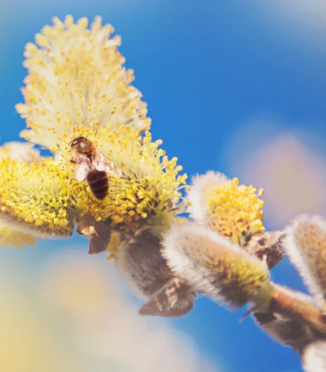
Introduction
What is pollen?
Pollen is a substance produced by flowering plants, trees, grasses, and weeds to fertilize other plants of the same species

Slide 5
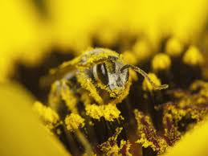
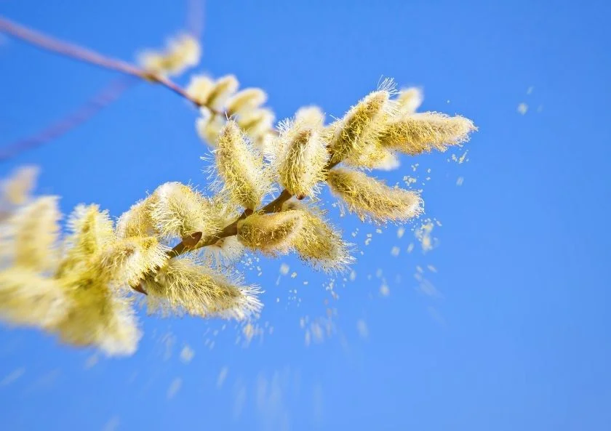
Introduction
Why pollen classification?
Accurate identification of pollen species is essential in ecology, agriculture, forensics and allergen studies.
Automated recognition of pollen species help saving time and increase accuracy.

Slide 6
Introduction
Desired outcome
Input : pollen image
Output : species name
Challenges
High variability in appearance and inter-class similarity:
Limited labeled data
Noisy image

Slide 7
Related Work
[1]Geraci, A., Polizzano, V., Marino, P. and Schicchi, R. (2012). Investigation on the pollen morphology of traditional cultivars of Prunus species in Sicily. Acta Societatis Botanicorum Poloniae, 81(3), pp.175–184. doi:https://doi.org/10.5586/asbp.2012.017.
[2] France, I., Duller, A.W.G., Duller, G.A.T. and Lamb, H.F. (2000). A new approach to automated pollen analysis. Quaternary Science Reviews, 19(6), pp.537–546. doi:https://doi.org/10.1016/s0277-3791(99)00021-9.
[3]Gonçalves, A.B., Souza, J.S., Silva, G.G. da, Cereda, M.P., Pott, A., Naka, M.H. and Pistori, H. (2016). Feature Extraction and Machine Learning for the Classification of Brazilian Savannah Pollen Grains. PLOS ONE, 11(6), p.e0157044. doi:https://doi.org/10.1371/journal.pone.0157044.
[4]Tsiknakis, N., Savvidaki, E., Manikis, G.C., Gotsiou, P., Remoundou, I., Marias, K., Alissandrakis, E. and Vidakis, N. (2022). Pollen Grain Classification Based on Ensemble Transfer Learning on the Cretan Pollen Dataset. Plants, 11(7), p.919. doi:https://doi.org/10.3390/plants11070919.

Slide 8
Method
Transfer learning
Data augmentation
DenseNet121

Slide 9
Method
Transfer learning?
Transfer learning (TL) is a technique in machine learning (ML?) in which knowledge learned from a task is re-used in order to boost performance on a related task.

Slide 10
Method
Data augmentation?
Data augmentation in image classification generating new training images by applying transformations to existing ones.
Techniques: geometric transformations (rotation, flipping), color adjustments, and noise injection, etc
-> Increase the diversity of the training set, improving the model’s robustness and generalization ability

Slide 11
Method
DenseNet121?
Convolutional neural network (CNN) architecture designed to enhance the flow of information and gradients between layers.
Introduced in the paper "Densely Connected Convolutional Networks" (2017) by Gao Huang et al.,
DenseNet121 is a specific variant with 121 layers.
-> Efficiency with small dataset, can achieve high performance even with limited computational resources.

Slide 12
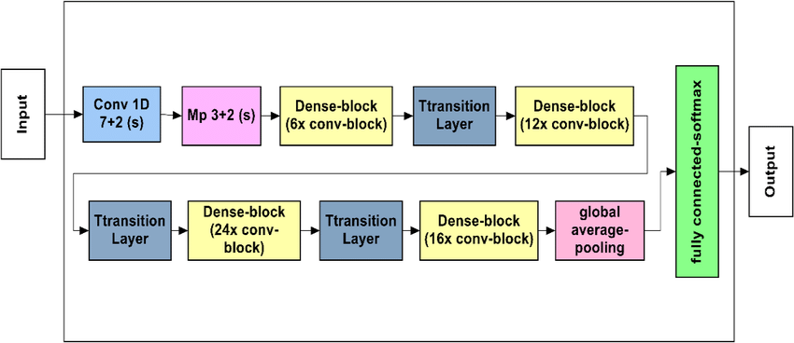
Method
DenseNet121?

Slide 13
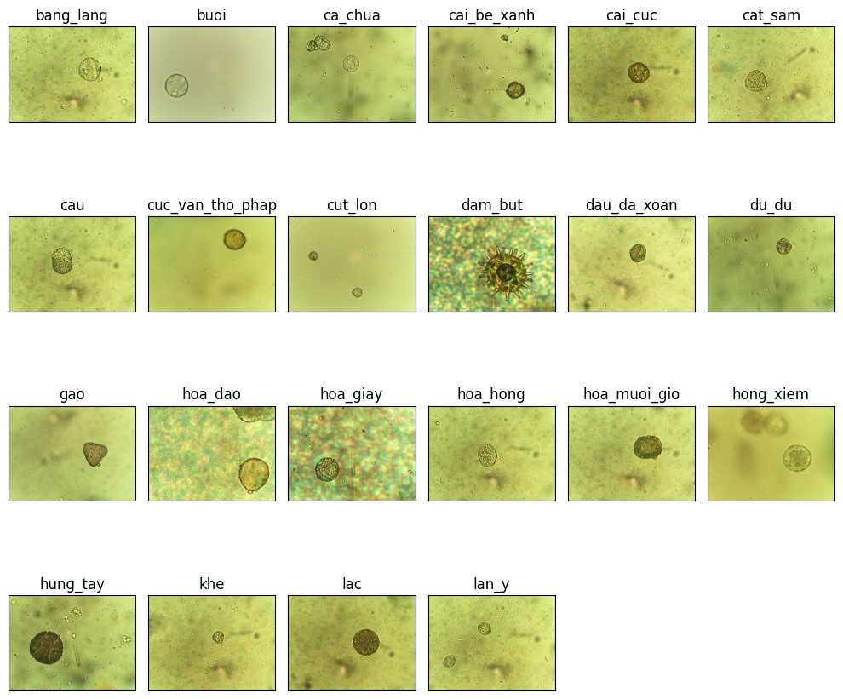
Experiment
Dataset
Pollen_VNUA subset
A dataset created by Vietnam National University of Agriculture
Subset of 22 species

Slide 14
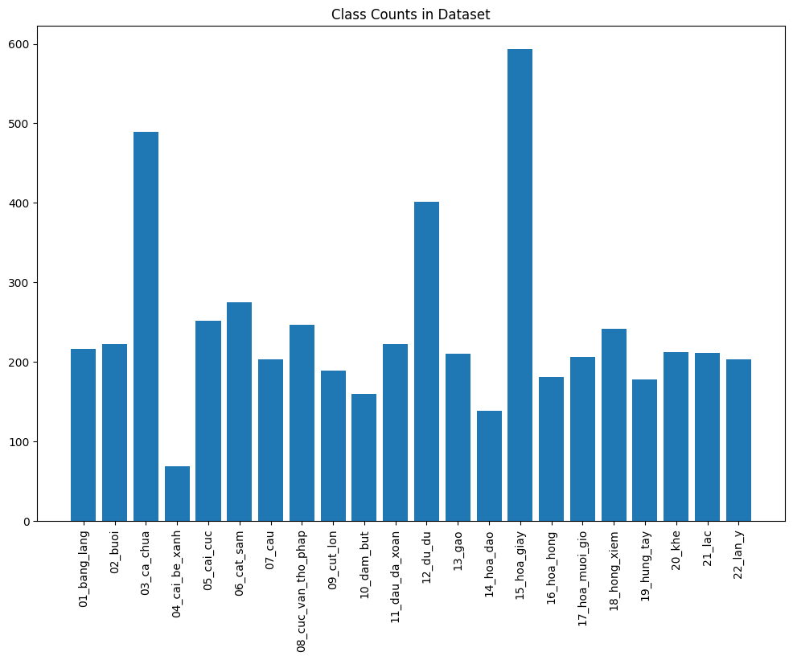
Experiment
Dataset

Slide 15
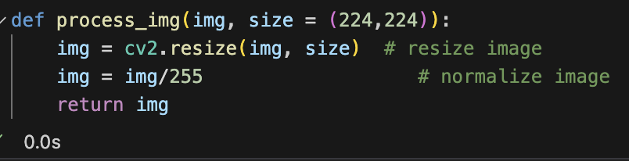
Experiment
Process
Preprocessing images to ensure they meet the input requirements for DenseNet121.

Slide 16
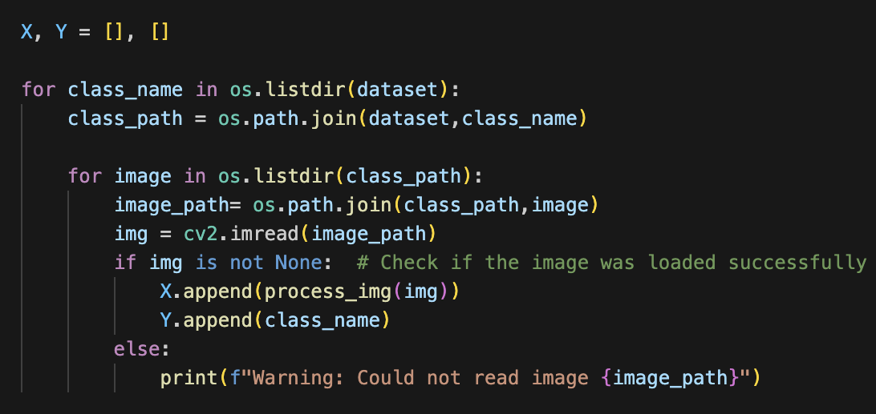
Experiment
Process
Append images and corresponding labels to list X[] and Y[]

Slide 17
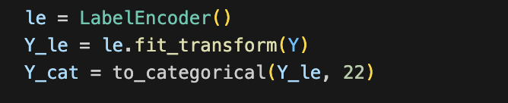
Experiment
Process
One-hot encode the labels

Slide 18
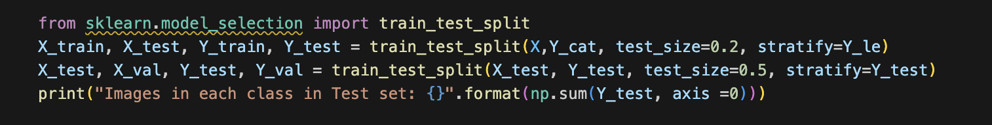
Experiment
Process
Split the dataset into train/validation/test

Slide 19
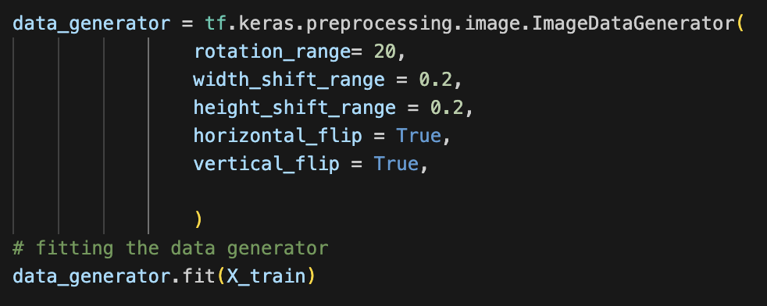
Experiment
Process
Data Augmentation

Slide 20
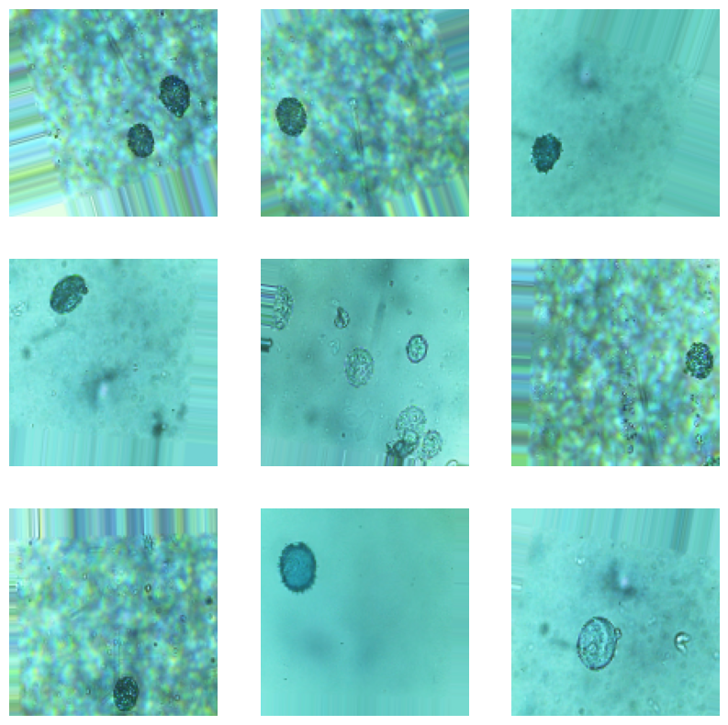
Experiment
Process
Data Augmentation

Slide 21
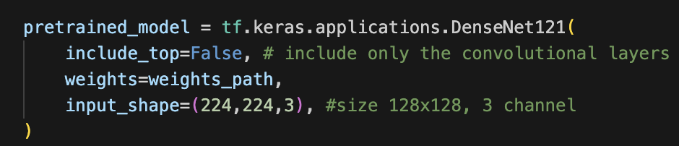
Experiment
Process
Model configuration
Base layer

Slide 22
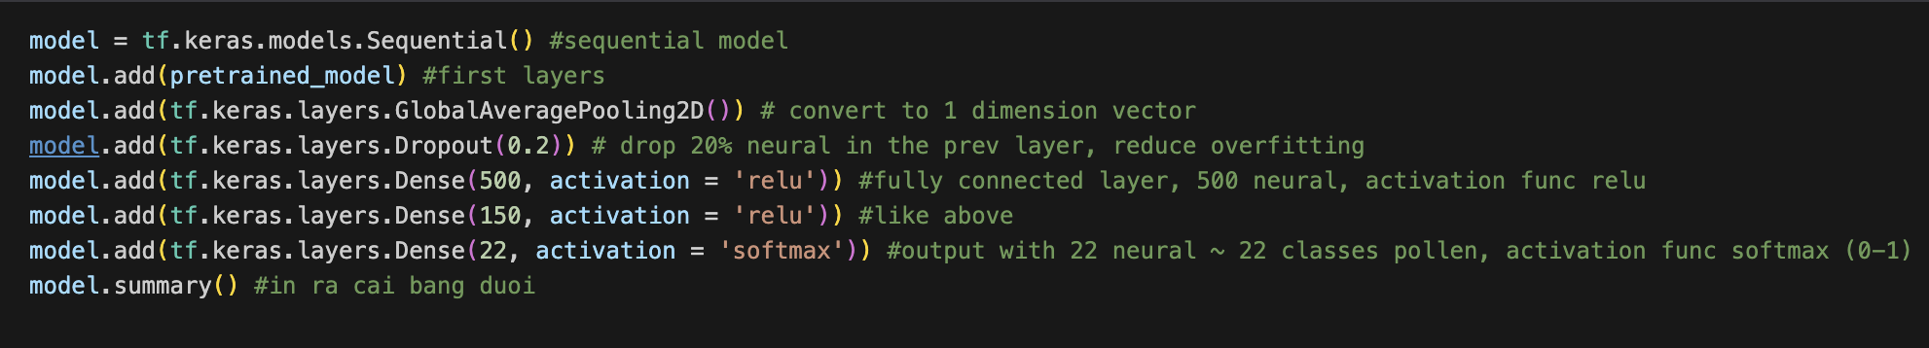
Experiment
Process
Model configuration
Modification layers

Slide 23
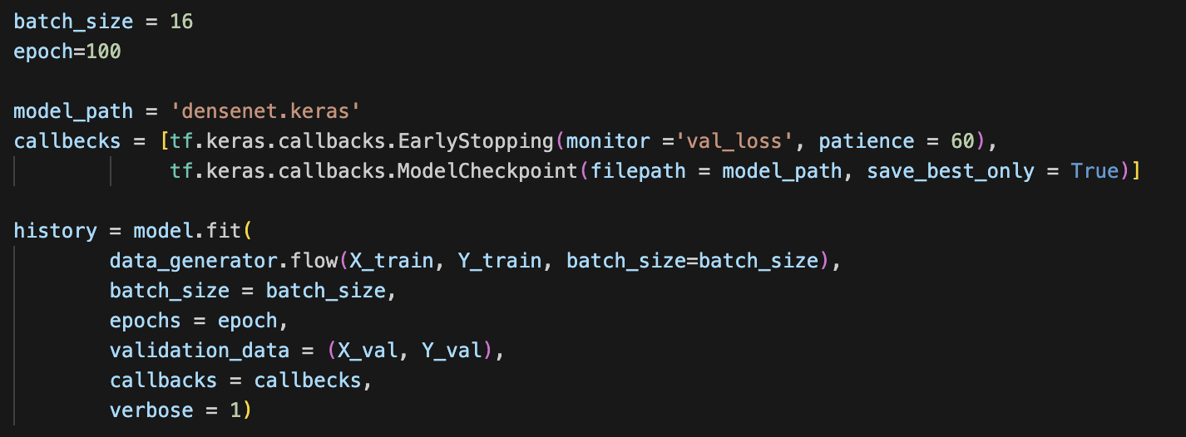
Experiment
Process
Training

Slide 24
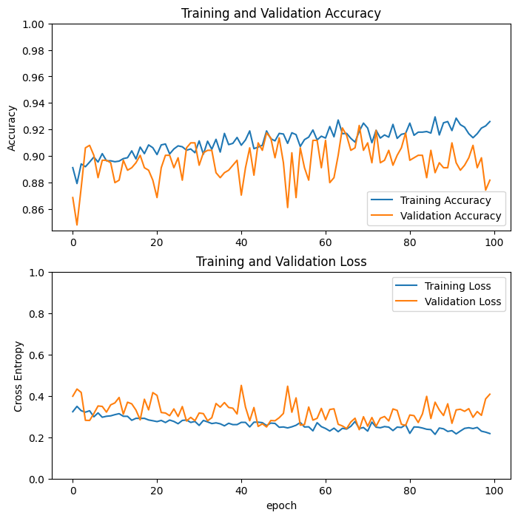
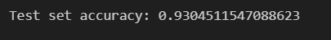
Experiment Result
The evaluation on the test set yielded an accuracy of approximately 92%, which is considered an acceptable result for the model at this stage.

Slide 25
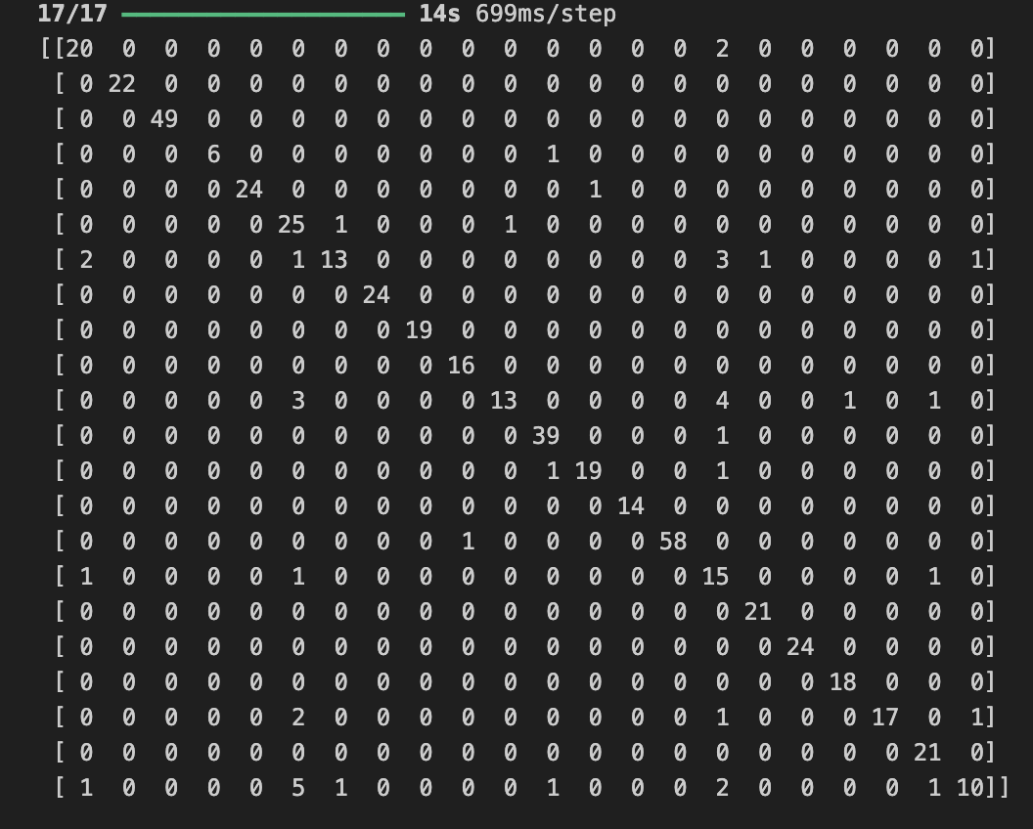
Experiment Result
Confusion Matrix

Slide 26
Conclusion & Future work
Project achievement
Developed an automated system for classifying pollen species using DenseNet121 and transfer learning.
Achieved 92% test accuracy despite limited data and inter-class similarity.
Optimized with data augmentation and dropout to prevent overfitting.
Challenges
Struggled with new images due to dataset bias.
Future Work
Enhance preprocessing by isolating pollen grains and addressing noise.
Experiment with different architectures and hyperparameters to improve robustness.

Slide 27
THANK YOU !

